Slide 1

LECTURE 10
I O N I C + E L E C T R O N P U B L I S H A P P
DANIEL R YS JAN VÁCL AVÍK

Slide 2
O V E R V I E W
Ionic + Electron
Publish app

Slide 3
E L E C T R O N
For building desktop apps
Supports Linux, Mac OS X, Windows
Wrap web app in chromium-based browser
Used by Slack, Avocode, Atom, Visual Studio Code, Postman,…

Slide 4
E L E C T R O N S I Z E P R O B L E M
Ionic app: ~10 MB
Electron app
Mac OS X: ~120 MB
Linux32: ~60 MB
Linux64: ~55 MB
Win ia32: ~48 MB
Win x64: ~66 MB

Slide 5
D O W N L O A D A P P F R O M L A S T L E C T U R E
$ git clone https://github.com/jvaclavik/image-warholizer
$ cd image-warholizer
$ git checkout 2.0
$ npm i
https://github.com/jvaclavik/image-warholizer/releases/tag/2.0

Slide 6
I N S TA L L E L E C T R O N
$ npm install
$ npm install
-g electron-prebuilt
-g electron-packager

Slide 7
P R E PA R E
Create www/electron.js for Electron configuration
Create www/package.json for Node configuration

Slide 8
E L E C T R O N C O N F I G U R AT I O N
www/electron.js
var app = require('app');
var BrowserWindow = require('browser-window');
var mainWindow = null;
app.on('window-all-closed', function () {
if (process.platform != 'darwin') { app.quit();
}
});
app.on('ready', function () {
mainWindow = new BrowserWindow({width: 1100, height: 900}); mainWindow.loadURL('file://' + dirname + ‘/index.html'); mainWindow.on('closed', function () {
mainWindow = null;
});
});

Slide 9
U P D AT E PA C K A G E . J S O N
www/package.json
{
"name": "Warholizer", "version": "0.1.0", "main": "electron.js"
}

Slide 10

U P D AT E PA C K A G E . J S O N
www/package.json
{
"name": "Warholizer", "version": "0.1.0", "main": "electron.js"
}
Which file should be executed

Slide 11
R U N E L E C T R O N A P P
$ cd www
$ electron .

Slide 12
A D D M E N U
http://electron.atom.io/docs/v0.28.0/api/menu/

Slide 13
A D D M E N U
www/menu.js
function sayHello() { alert("Hello") } const remote = require('electron').remote; const Menu = remote.Menu;
menuTemplate = [
{
label: "Important menu", submenu: [
{
label: "Say hello", click: sayHello
}
]
}
];
if (process.platform === 'darwin') menuTemplate.unshift({
label: "Basic", submenu: [
{
label: 'About ', role: 'about'
}
]
});
Menu.setApplicationMenu(Menu.buildFromTemplate(menuTemplate))

Slide 14
A D D M E N U S C R I P T
www/index.html
<script src="menu.js"></script>

Slide 15
A D D I C O N ( F O R M A C O S X )
convert PNG to ICNS (Apple icon format)
https://iconverticons.com/online/

Slide 16
A D D I C O N ( F O R M A C O S X )
Use electron packager
Copy icon to generated app
$ electron-packager . Warholizer --ignore=node_modules/
electron-* --platform=darwin --arch=x64
--overwrite && cp ../resources/icon.icns
--version=0.36.10 Warholizer-
darwin-x64/Warholizer.app/Contents/Resources/atom.icns

Slide 17

A D D I C O N ( F O R M A C O S X )
Use electron packager
Copy icon to generated app
$ electron-packager . Warholizer
--ignore=_{C}n_{o}o_{n}d_{s}e_{o}__{l}m_{e}o_{h}d_{e}u_{l}l_{l}e:s₋₎/
electron-* --platform=darwin --arch=x64 --version=0.36.10
--overwrite
&& cp ../resources/icon.icns Warholizer- darwin-x64/Warholizer.app/Contents/Resources/atom.icns

Slide 18
C R E AT E N P M S C R I P T
www/package.json
{
"name": "Warholizer", "version": "0.1.0",
"main": "electron.js", "scripts": {
"start": “electron .”,
"build": "electron-packager . Warholizer --ignore=node_modules/electron-* -- platform=darwin --arch=x64 --version=0.36.10 --overwrite && cp ../resources/ icon.icns Warholizer-darwin-x64/Warholizer.app/Contents/Resources/atom.icns"
},
"devDependencies": {
"asar": "^0.10.0",
"electron-packager": "^3.2.0", "electron-prebuilt": “^0.25.2"
}
}

Slide 19
R U N N P M S C R I P T
$ npm run-script build

Slide 20
W E B C A M E R A I M P L E M E N TAT I O N

Slide 21
W E B C A M E R A I M P L E M E N TAT I O N
app/utility.js
export class Utility { constructor() {}; static isElectron(){
return (window && window.process && window.process.type)
|| !window.cordova;
};
}

Slide 22
W E B C A M E R A I M P L E M E N TAT I O N
app/pages/choose-action/choose-action.html
<ion-navbar *navbar>
<button menuToggle *ngIf="!isElectron()">
<ion-icon name="menu"></ion-icon>
</button>
<ion-title>New Effect</ion-title>
</ion-navbar>
<ion-content padding class="choose-action">
<button block (click)="getPicture('device')" *ngIf="!isElectron()"> Choose from device
</button>
<button block (click)="getPicture('camera')">Take a picture</button>
<video id="video" width="100%" autoplay *ngIf="isElectron()"></video>
<button class="button button-block button-secondary"
id="snap" (click)="snapPhoto($event)" *ngIf="isElectron()">Snap Photo</button>
<canvas class="hide" id="canvas" width="640" height="480"></canvas>
</ion-content>

Slide 23
A D D U T I L I T Y
app/pages/choose-action/choose-action.js
...
import {Utility} from '../../utility';
@Page({
templateUrl: 'build/pages/warholize/warholize.html', providers: [GalleryProvider]
})
export class ChooseActionPage {
...
isElectron(){
return Utility.isElectron();
}
}

Slide 24
A D D U T I L I T Y
app/pages/choose-action/choose-action.js
snapPhoto(event){
var canvas = document.getElementById("canvas"); var context = canvas.getContext("2d"); context.drawImage(video, 0, 0, 640, 480);
this.nav.push(CropperPage, {imageData: canvas.toDataURL("image/jpeg")});
}

Slide 25
W E B C A M E R A I M P L E M E N TAT I O N
app/pages/choose-action/choose-action.js
getPicture(source) {
...
Camera.getPicture(options).then((imageData) => {
this.nav.push(CropperPage, {imageData: imageData});
}, (err) => {
if(source !== 'device'){
var video = document.getElementById("video");
var videoObj = { "video": true };
var videoErrorHandler = function(error) { console.error("Failed to capture video: ", error.code);
};
if(navigator.getUserMedia) { // Standard navigator.getUserMedia(videoObj, function(stream) {
video.src = stream; video.play();
}, videoErrorHandler);
} else
if(navigator.webkitGetUserMedia) { // WebKit-prefixed navigator.webkitGetUserMedia(videoObj, function(stream){
video.src = window.webkitURL.createObjectURL(stream); video.play();
}, videoErrorHandler);
}
} else{
...
}
});
}
25/47

Slide 26
A D D U T I L I T Y
app/pages/warholize/warholize.js
...
import {Utility} from '../../utility';
@Page({
templateUrl: 'build/pages/warholize/warholize.html', providers: [GalleryProvider]
})
export class WarholizePage {
...
isElectron(){
return Utility.isElectron();
}
}
26/47

Slide 27
S AV E A S I M A G E
app/pages/warholize/warholize.js
applyEffect(orientation) {
...
let wrh = new Warholizer({
...
onRenderFinished: () => { loading.dismiss(); if(Utility.isElectron()){
var canvases = document.querySelectorAll('canvas');
for(var i = 0; i < canvases.length; i++){ var parent = canvases[i].parentElement; if(parent.id == 'previews'){
var a = document.createElement('a');
a.href = canvases[i].toDataURL('image/jpeg'); a.download = 'stripes.jpg'; a.appendChild(canvases[i]); parent.appendChild(a);
}
}
}
},
cloneClickedHandler: (target) => {
if(!Utility.isElectron()) this.showActionSheet(target);
}
});
...
}

Slide 28
D I S A B L E S I D E M E N U
app/app.js
...
import {Utility} from './utility';
@App({
templateUrl: 'build/app.html', config: {}
})
class MyApp {
static get parameters() {
return [[IonicApp], [Platform], [MenuController]];
}
constructor(app, platform, menu) {
this.menu = menu;
...
}
initializeApp() {
this.platform.ready().then(() => {
...
if (Utility.isElectron()) {
this.menu.swipeEnable(false);
}
});
}
...
}

Slide 29
P U B L I S H A P P L I C AT I O N O N G O O G L E P L AY

Slide 30
R E G I S T E R G O O G L E P U B L I S H E R A C C O U N T
Registration fee: $25
http://developer.android.com/distribute/googleplay/ start.html

Slide 31
P R E PA R E C O N F I G . X M L
ID
Name
Version
Icon & splash screen

Slide 32
S I G N I N G A P K

Slide 33
G E N E R AT E K E Y
$ keytool -genkey -v -keystore warholizer.keystore - alias warholizer -keyalg RSA -keysize 2048 -validity 10000

Slide 34
G E N E R AT E K E Y
$ keytool -genkey -v -keystore warholizer.keystore -alias warholizer 10000
Enter keystore password:
-keyalg
RSA -keysize
2048 -validity
Keystore password is too short - must be at least 6 characters Enter keystore password:
Re-enter new What is your [Unknown]:
password:
first and last name? Jan Vaclavik
What is the name of your organizational unit? [Unknown]: Userte.ch
What is the name of your organization? [Unknown]: Userte.ch
What is the name of your City or Locality?
[Unknown]: Prague
What is the name of your State or Province? [Unknown]: Czech Republic
What is the two-letter country code for this unit? [Unknown]: CZ
Is CN=Jan Vaclavik, OU=Userte.ch, O=Userte.ch, L=Prague,
[no]: yes
ST=Czech
Republic, C=CZ
correct?
Generating 2?048 bit RSA key pair and self-signed certificate (SHA1withRSA) with a validity of for: CN=Jan Vaclavik, OU=Userte.ch, O=Userte.ch, L=Prague, ST=Czech Republic, C=CZ
Enter key password for <warholizer> (RETURN if same as keystore password):
Re-enter new password: [Storing warholizer.keystore]
10?000 days

Slide 35
R E L E A S E B U I L D
$ cordova build android --release

Slide 36
A P K S I G N I N G
$ jarsigner -verbose -sigalg SHA1withRSA -digestalg SHA1 -keystore warholizer.keystore android-release-
unsigned.apk warholizer

Slide 37
S I G N I N G C H E C K
$ jarsigner -verify -verbose -certs android-release- unsigned.apk

Slide 38
C R E AT E A P K
$ zipalign -v 4 android-release-unsigned.apk android-
release-signed.apk

Slide 39
W H AT N E E D S T O F I L L I N G O O G L E P L AY
Name
Short description (≤ 80 characters)
Full description (≤ 4000 characters)
Screenshots (2–8 images)
On the phone: Hold power and volume down button
Icon (512 × 512px)
Main graphics (1024 × 500px)
Application type (Application/game)
Category
Content rating
E-mail

Slide 40
D E P L O Y O N G O O G L E P L AY
https://play.google.com/apps/publish/

Slide 41
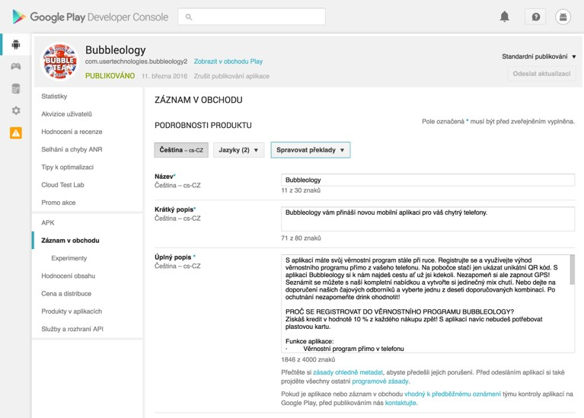
D E P L O Y O N A P P S T O R E

Slide 42
P U B L I S H O N A P P S T O R E

Slide 43
R E G I S T E R A P P L E D E V E L O P E R A C C O U N T
Register developer account
$99 per year
https://developer.apple.com/support/compare- memberships/

Slide 44
P U B L I S H O N A P P S T O R E
Create production certificate of your company
Create identifier for the app
Create distribution provisioning profile
Deal with xCode
Upload to iTunesConnect
Publish on App Store (takes a week)

Slide 45
P U B L I S H O N A P P S T O R E
iTunesConnect
For publishing apps
itunesconnect.apple.com
Developer Account
For generating certificates
developer.apple.com

Slide 46
Q U E S T I O N S ?

Slide 47
JAN VÁCL AVÍK
@janvaclavik
DANIEL R YS
@danielrys
WW W.USER TECHNOLOGIES.COM

